Slide 1
Your Partner of Choice for Educational Headsets
June 2026

Slide 2

Agenda
The AVID Difference
Education Focused Headsets
Economy Headphones and Earbuds
AVID Marketing Tools and Value Services

Slide 3



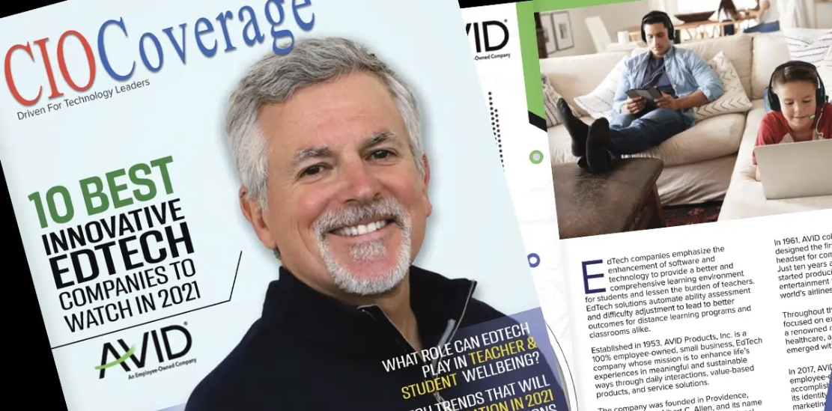
Our legacy. It’s what makes AVID trusted worldwide
for audio solutions—proven, reliable, and built for lasting success.
In 1961, AVID created the
first in-flight headphone for
TWA—soon supplying
97% of airlines worldwide.
Celebrating 73 years!
Our story started in 1953,
right in Providence, RI.
In 2021, CIO Coverage named AVID one of the
Ten Best Innovative EdTech Companies
We became a
100% employee-owned
company in 2017

Slide 4
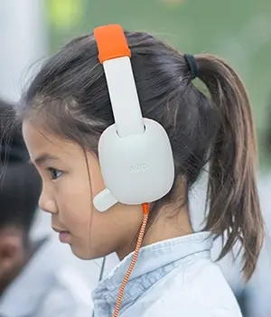

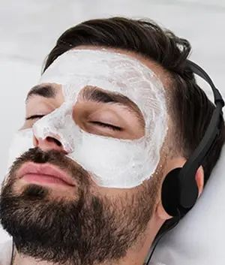

Markets we proudly serve
Education
Healthcare
Hospitality
Travel
Empowering the learning experience
Improving the patient experience
Enhancing the guest experience
Upgrade your
journey
Classroom
Remote Learning
STEM
Hospitals
Care Centers
Dialysis Centers
Hotels
Fitness Centers
SPA
Airplanes
Trains, Bus & Cruise
Museums

Slide 5




9.1 million+
Students are learning with AVID headsets.
6,000+
Schools & districts trust AVID headsets.
13
Education Excellence and Best of Show Awards since 2020.
These aren’t just numbers—they’re a whole lot
of confidence in solutions that perform.
Your Partner of Choice for
Educational Headsets

Slide 6







Award-winning
headsets designed
for students' success
– affordable, durable, and trusted by educators to support student learning.

Slide 7
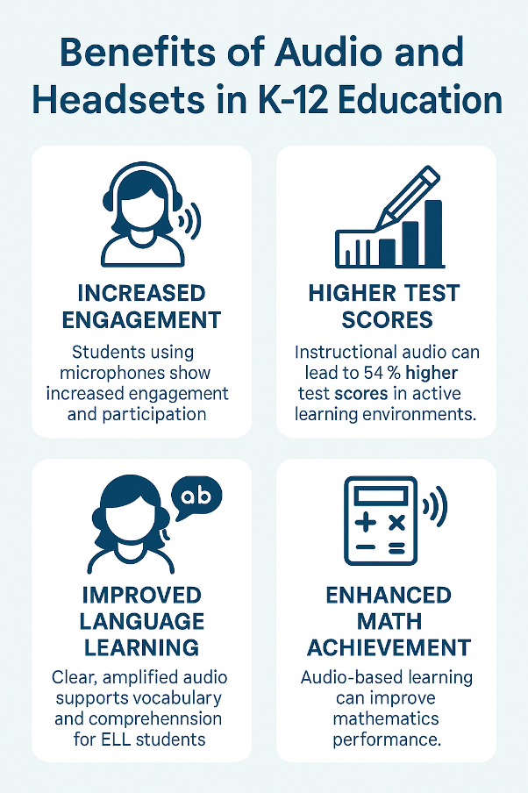
Importance of Audio in Education
76%
Vocabulary Boost
(American Secondary Education)
50%
Participation Rates
(NEA EdTech Report, 2021)
46%
Comprehension Scores
(Journal of Special Education Tech, 2019)
10%
Improvement in test scores with
instructional audio (MARRS Project, 2005)

Slide 8
Education Trends
K-12 Planning at a Glance
Budget Environment: 2026-2027
Shift 1:1 Device to Classroom Carts
Enhanced Audio Learning with AI Platforms
23
52%
86%
States project flat or declining ed budgets in FY2026
of districts worry
about 1:1 program
viability post-ESSER
of students used AI
tools in the 2024-2025 school year
NASBO Fiscal Survey.
Fall 2025
Bluum survey of 241 schools, 2025
CDT Survey Report,
2025
Importance of Audio in Education
76%
Vocabulary Boost
46%
Comprehension Scores
50%
Participation Rates
10%
Test Scores

Slide 9



Why headsets matter in education
Keeps students focused by blocking out distractions so they can stay on task.
Supports self-paced learning so students can learn in the way that works best for them.
Promotes Interactive Learning – Hear and be heard for better learning results.
But not all headsets are equal.
Quality matters, especially in the classroom.

Slide 10







AVID Headsets are State Testing Recommended
Designed to meet state testing and assessment requirements
…and many more
Taking the worry out of the equation!
Reliable Performance =
Student and Teacher success

Slide 11

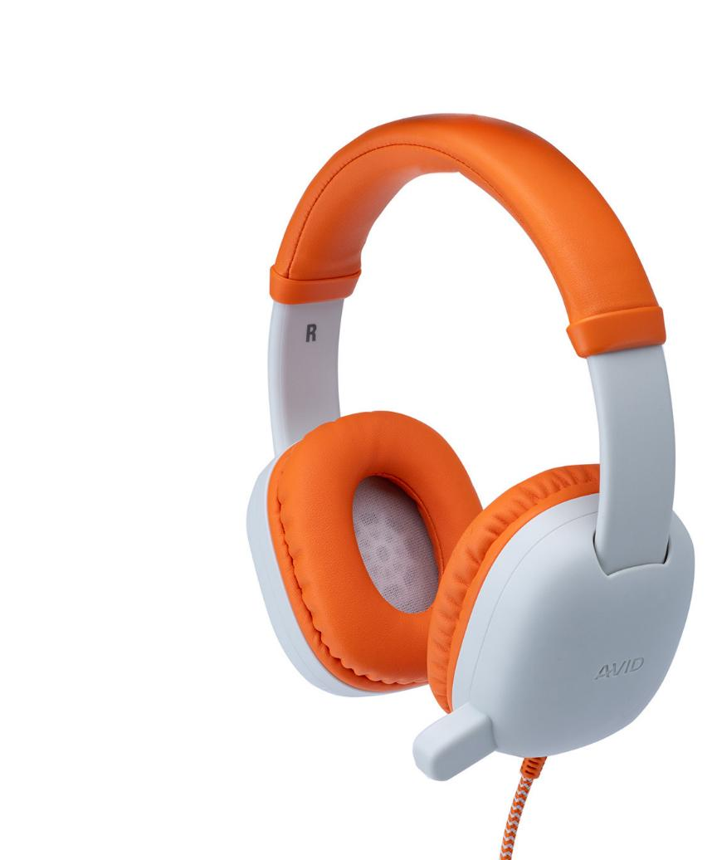

The AVID Difference
Made for Students, Built to Fit – Comfortable, kid-ready designs for every learner.
Durability Tested – Drop it, twist it, stuff it in a backpack—it’s built to take it.
Safer Listening – Volume-limiting technology for safer listening*
Clear Communication – Noise-canceling mics make sure every word comes through.
Affordability – Budget-friendly for schools, districts, and even parents.
Compliance and Testing Ready – Compliant with state and federal guidelines.
Safety Certifications – Meets global safety standards for total peace of mind.
*WonderEars headset

Slide 12
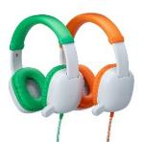
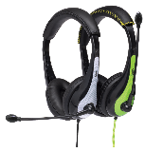
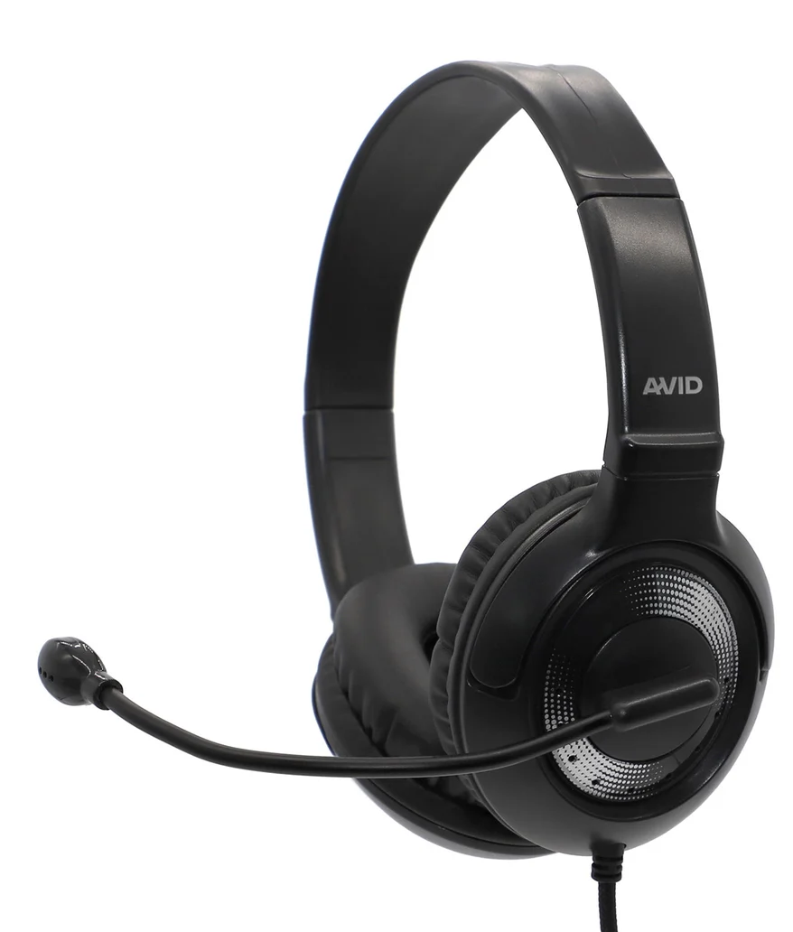
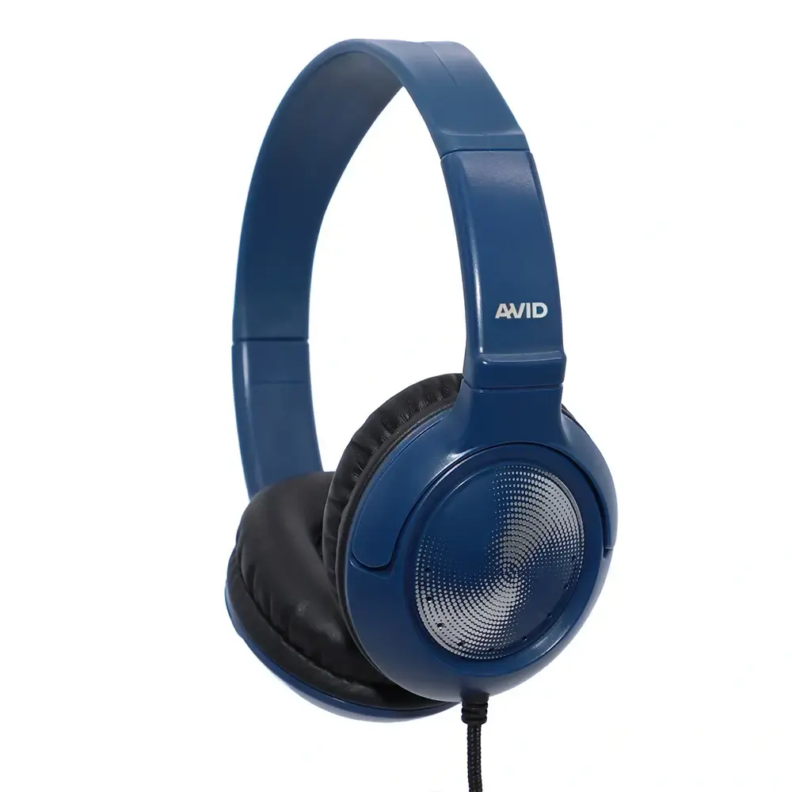

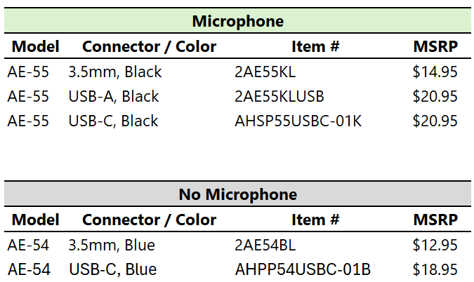
Featured Education Headsets
WonderEars™
30-Series
50-Series
Early Learners: Pre-K to 4th Grade
(ages – 4-9)
Primary & Secondary Learners
Remote and Backoffice workers
Middle & High School Learners
Remote and Backoffice workers
KidCom™ Built-in Microphone – Durable, kid-friendly design with a mic fixed on the earcup, ensuring consistent voice pickup without the distraction of a boom mic.
Volume limited to 85dB for safer listening
Padded cushion earcups and adjustable headband
2-year warranty
Durable & lightweight
On-ear padded earcups
Adjustable and padded headband
Noise-canceling boom mic*
2-year warranty
Ambidextrous 270º rotating noise-canceling boom mic for right or left ear placement*
On-ear, Vertical tilting, padded earcups
Adjustable headband
Built to meet strictest testing standards, including TELPAS
2-year warranty
* Available on microphone models

Slide 13
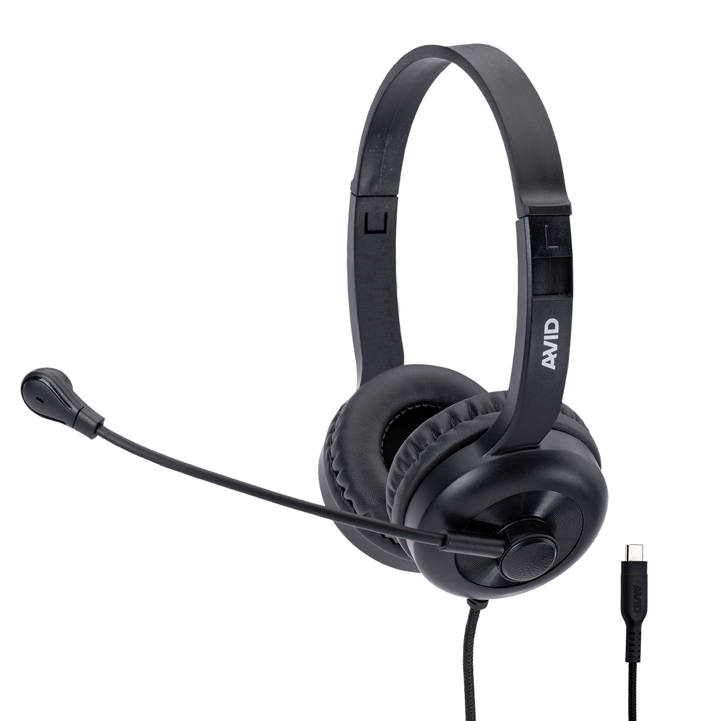

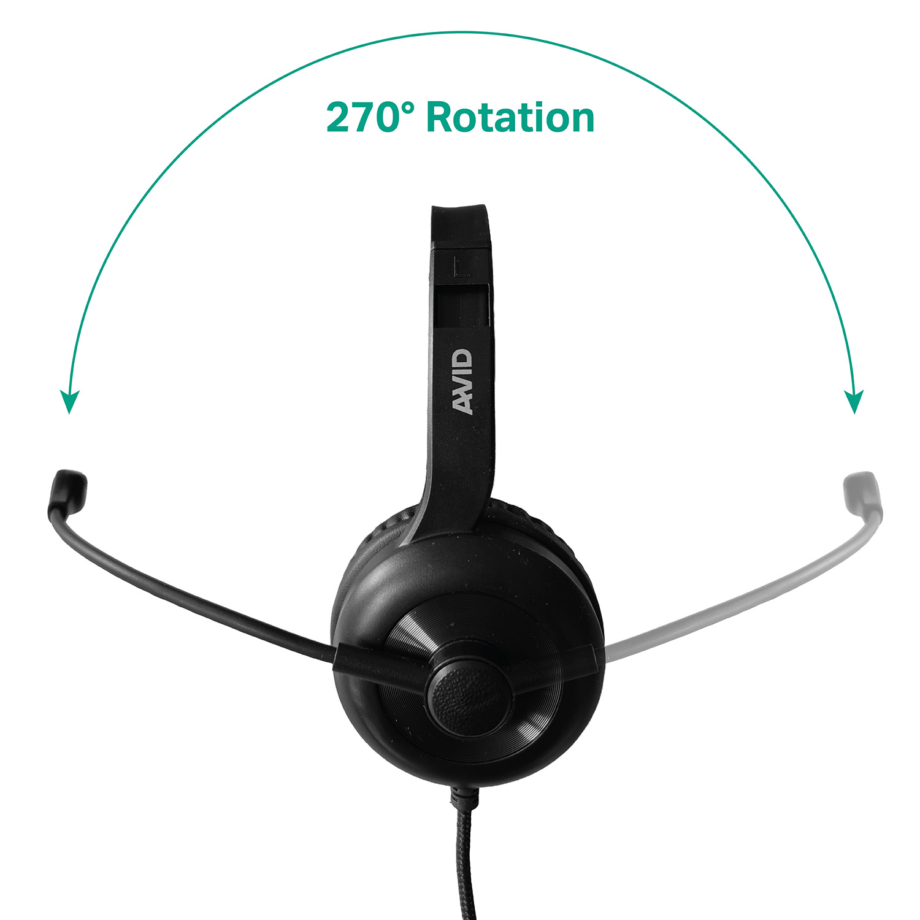
AE-15 Headset
Designed for the classroom with durability and value (USB-C)
Designed for everyday classroom use
270° Ambidextrous swivel boom with omnidirectional microphone
Adjustable headband for a comfortable fit across all age groups
Padded earcups
4-Foot nylon braided cord
Universal USB-C connection
2-Year Warranty
Item #: AHSP15USBC-01K
Availability: July 2026
MSRP: $12.95

Slide 14
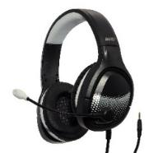
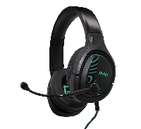
Premium Education Headsets
70-Series
AVIGA™
Middle and High School Learners
College and remote workers
Middle and High School Learners
Ideal for STEM
Large speaker delivers clear, natural sound with deep bass
Over ear design for passive noise cancelation and comfortable extended use
Flexible boom and noise-canceling microphone
Luxurious padding and adjustable headband
2-year warranty
Large speaker delivers clear, natural sound with deep bass
Over ear design for passive noise cancelation and comfortable extended use
Swivel-to-mute mic and easy access volume control on ear cup
Adjustable and padded headband for long wear
2-year warranty

Slide 15









AVID Economy Headsets and Earbuds
Quality and Value to Enhance Everyday Experiences
Education
Commercial

Slide 16
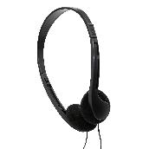
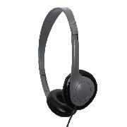
Economy Series Headphones
Better Audio, Smarter Spending
Foam
ear cushion
Vinyl
ear cushion
AE-08
AE-711
A perfect blend of lightweight construction,
Comfort, and clear sound quality
A quality sound experience in a sleek, compact design
Key Benefits:
Lightweight design keeps students focused without discomfort
Perfect for testing and limited use
Compatible with a wide range of devices
Budget-friendly
Slim & Sleek Design - Low-profile, adjustable headband and soft foam ear cushions provide a secure fit for extended use.
Clear Stereo Sound - Delivers balanced audio for media, listening activities, music and more.
Budget-Friendly Headphone - Affordable solution for large-scale deployments in schools, libraries, testing centers and multimedia learning.
3.5mm Connectivity - Universal connection - no adapters or drivers needed.
Warranty – No Warranty. Return of unused, in original packaging within 30-days
Slim & Sleek Design - Low-profile, adjustable headband and soft vinyl ear cushions provide a secure fit for extended use.
Clear Stereo Sound - Delivers balanced audio for media, listening activities, music and more.
Cost-Effective and Easy to Clean - ideal for high-volume use in schools with wipeable vinyl earcups and a design built for bulk educational deployments.
3.5mm Connectivity - Universal connection - no adapters or drivers needed.
Warranty – No Warranty. Return of unused, in original packaging within 30-days
Item # | Connection | MSRP
2AE08STEREO32 | 3.5mm | $1.95
Item # | Connection | MSRP
2AE711E35 | 3.5mm | $4.95
AHPP711USBC-01E | USB-C | $6.65

Slide 17
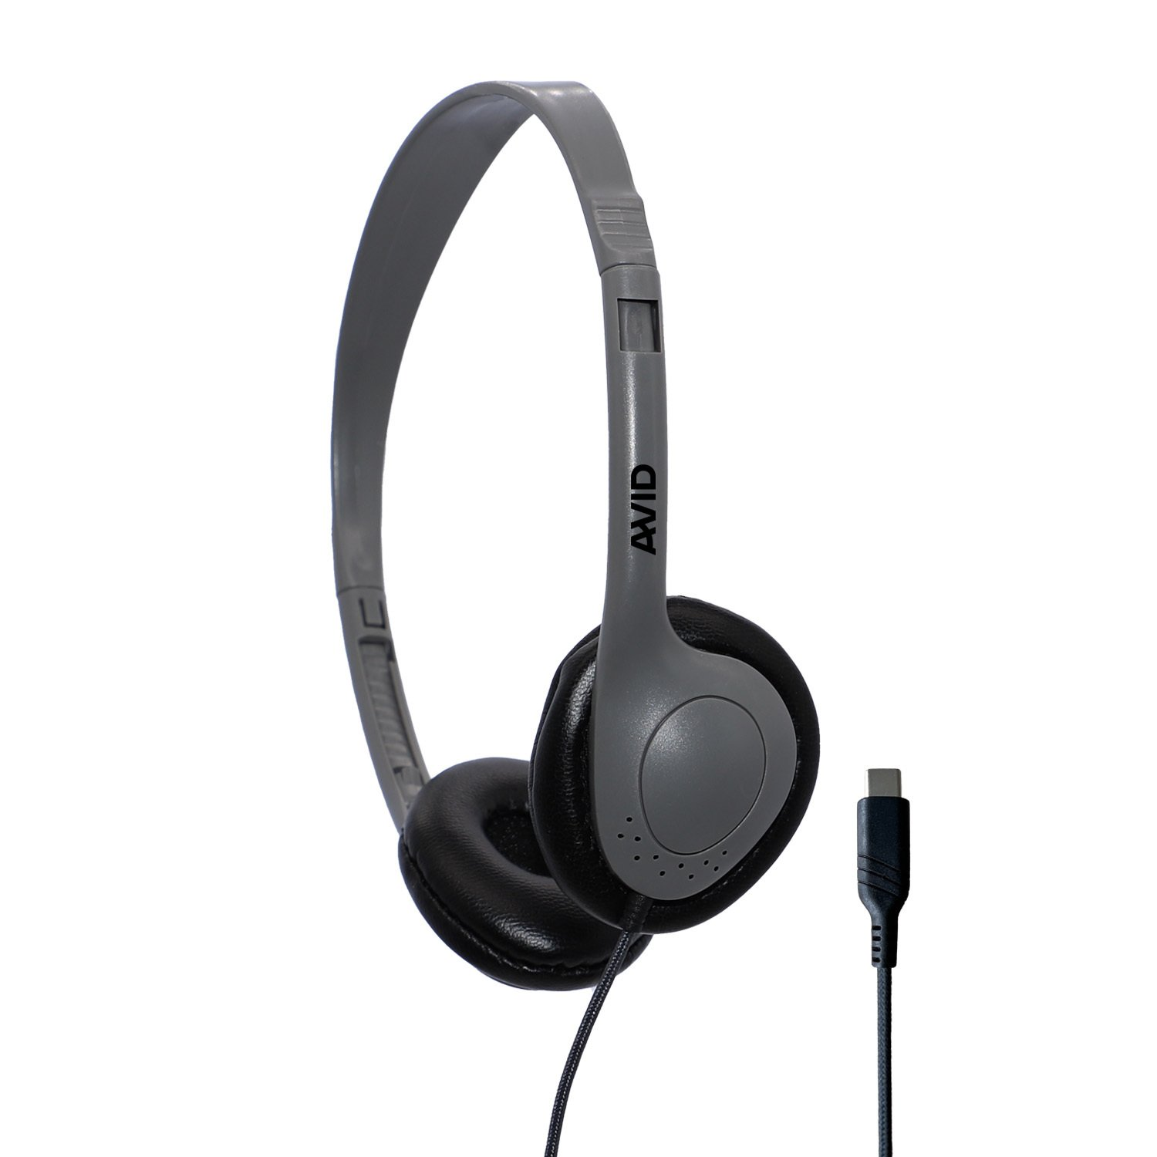
AE-711 Economy Headphone (USB-C)
Confidential – Under Embargo (Announcing June 2, 2026)
Disposable healthcare headphones are single-use, cost-effective audio devices designed for patient hygiene, often used in hospitals, MRIs, and clinics to prevent cross-contamination.
Featherlight comfort – Super-light frame for all-day wear.
Disposable headphone
Durable – 5ft braided nylon cord.
Universal compatibility – USB-C plug
Item #: AEPP711USBC-01E
Availability: Late-June 2026
MSRP: $6.65

Slide 18
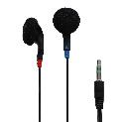
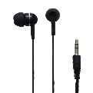
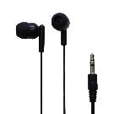
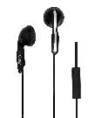
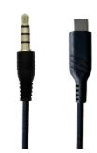
Economy Series Earbuds
Affordable. Reliable. Ready for Learning.
Outer Ear
Foam tip
In Ear
Silicone tip
In Ear
Silicone tip
Outer Ear
Microphone
O3
JS-75
AE-205
AE-215
AE-1M
Plug in. Tune in.
Take on the day.
Snug fit. Easy comfort. Built for every classroom environment.
Secure fit. Comfortable Wear. Ready for any classroom.
Stay connected - anywhere, anytime. Your all-in-one audio solution
Key Benefits:
Lightweight and compact for easy use and storage
Perfect for labs, interactive lessons, and everyday classroom activities
Perfect for testing and limited use
Compatible with a wide range of devices
Earbuds with and without Microphone
Cost-Effective and Disposable Option - Individually packaged and affordably priced for bulk distribution.
Comfort that lasts- Soft foam earpads rest gently on your ears for a secure, comfortable fit.
On-ear design - sits outside the ear canal for a comfortable fit that keeps users aware of their surroundings.
3.5mm Connectivity - Universal connection - no adapters or drivers needed.
Warranty - Return of unused, in original packaging within 30-days
Soft silicone tips - comfortable, secure fit that reduces ambient noise and enhances audio clarity.
Clear, Balanced Sound Quality - These earbuds deliver crisp audio, ideal for everyday use.
Budget-Friendly and Bulk-Ready - offer reliable performance at an affordable price.
3.5mm Connectivity - Universal connection - no adapters or drivers needed.
Warranty - Return of unused, in original packaging within 30-days
Soft silicone tips - comfortable, secure fit that reduces ambient noise and enhances audio clarity.
Clear, Balanced Sound Quality - These earbuds deliver crisp audio, ideal for everyday use.
Budget-Friendly and Bulk-Ready - offer reliable performance at an affordable price.
3.5mm Connectivity - Universal connection - no adapters or drivers needed.
Warranty - Return of unused, in original packaging within 30-days
In-Line Microphone - Features a built-in omnidirectional mic for clear voice capture.
On-ear design - sits outside the ear canal for a comfortable fit that keeps users aware of their surroundings.
Cost-Effective and Disposable Option Individually packaged and affordably priced for bulk distribution.
3.5mm or USB-C Connectivity - Universal connection - no adapters or drivers needed.
Warranty - Return of unused, in original packaging within 30-days
Item # | MSRP
8KIT00JS75BOXED | $0.95
Item # | MSRP
2205BLKSLVBOX100 | $1.25
Item # | MSRP
1AE215HPBLKSTK | $1.25
Item # |  | MSRP
2AE16993632MIC | 3.5mm | $2.25
AEPP1MUSBC-01K | USB-C | $3.95

Slide 19
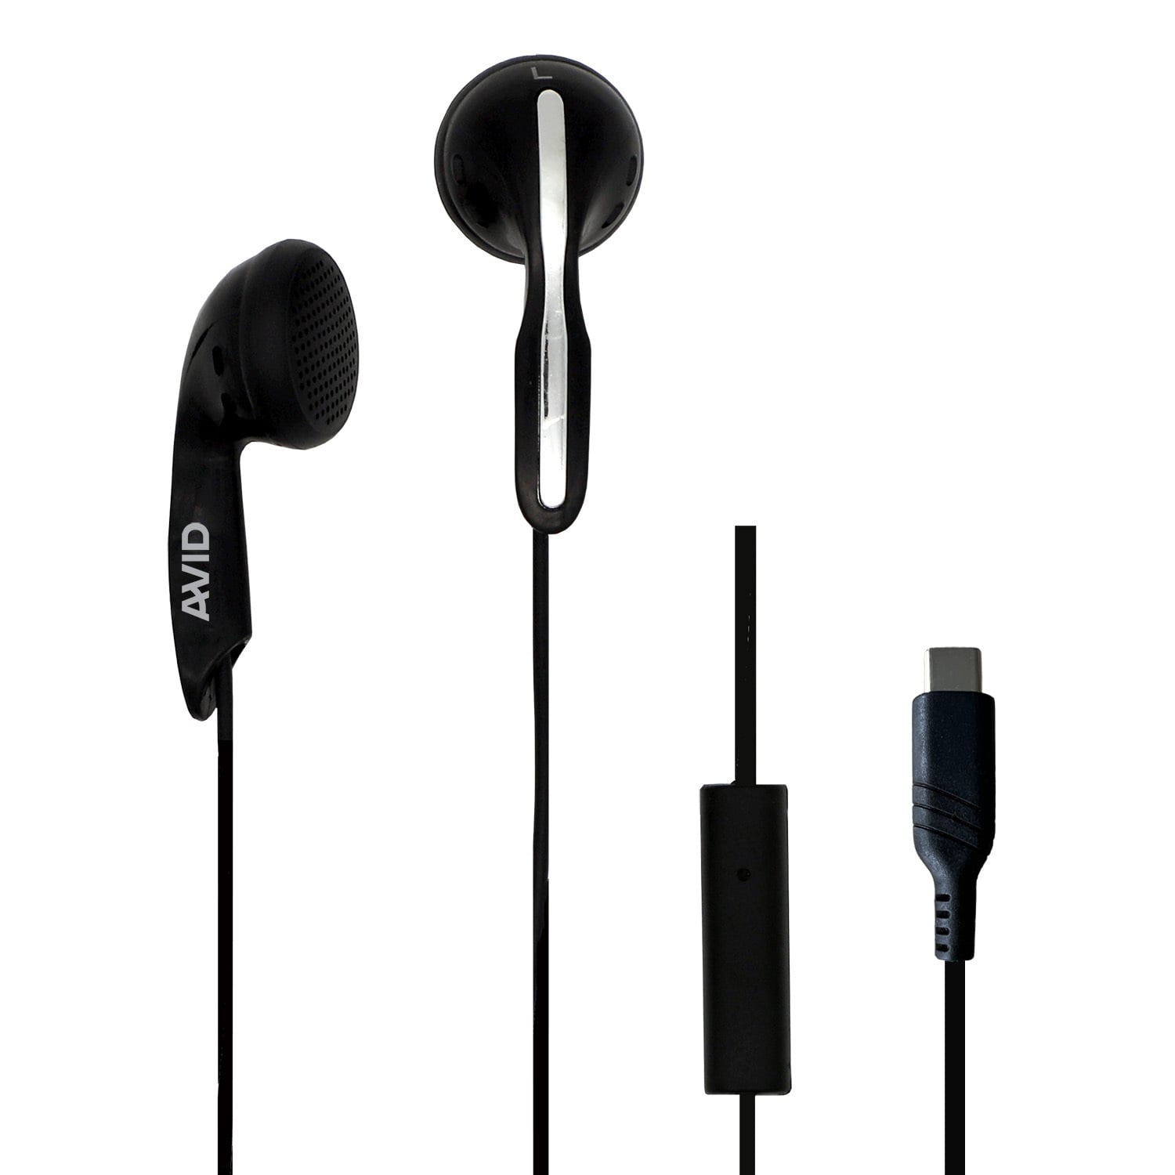
AE-1M Earbud (USB-C)
Confidential – Under Embargo (announce June 2, 2026)
Budget-friendly, wired stereo earbud with an in-line microphone designed primarily for education, healthcare, and single-use scenarios.
Comfortable design that sits on the outer ear
Easy to clean and store
Individually wrapped for hygiene and convenience
In-line microphone
USB-C plug
Item #: AEPP1MUSBC-01K
Availability: Late-June 2026
MSRP: $3.95

Slide 20
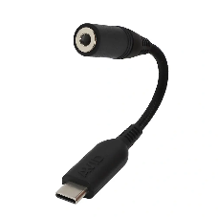
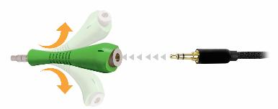
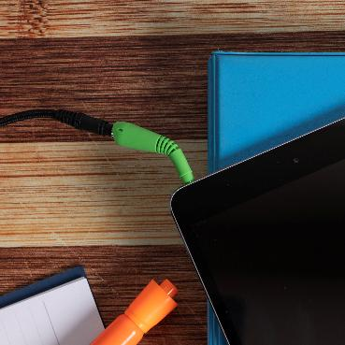
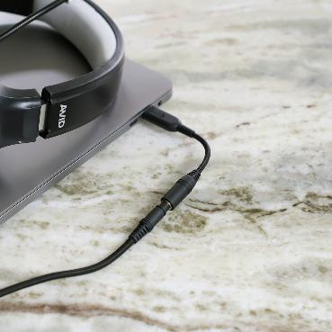

Headset Accessories
Fishbone Flexible Breakaway Adapter
USB-C to 3.5mm Flexible Breakaway Adapter
Flexible 360-degree input. Plug in from any angle without straining your device’s audio pin.
Pin protection — Say goodbye to broken audio pins stuck inside your devices.
Compact, seamless fit, provides secure connection without any interference.
Flexible input angles protect your device’s audio port.
Effortlessly connect 3.5mm audio solutions to any USB-C device.
Plug & Play compatibility with Android, Apple, and Windows 10/11 devices.
Safer listening — volume capped below 96dB* for a worry-free audio experience.
Item # | MSRP
5ADPFISHBONE | $2.75
Item # | MSRP
ADPPTRRSUSBC-01K | $8.45
*depending on the headset’s
volume limiting capabilities

Slide 21
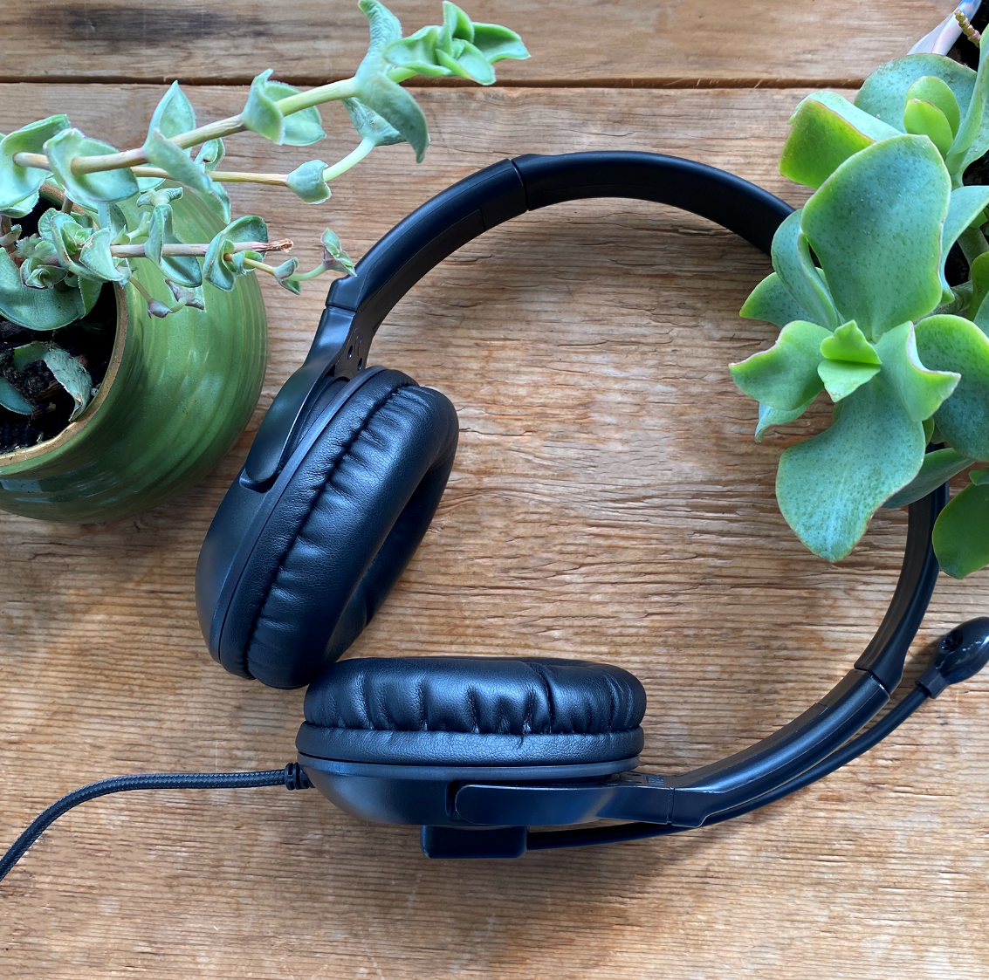


Got old headsets?
Join our free and easy Audio Recycle Program and give used headphones, headsets, and earbuds (of any brand!) a second life.
Our commitment to helping keep
the Earth beautiful!
Get Started

Slide 22
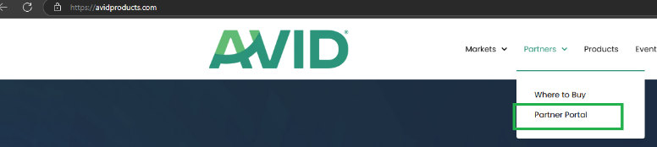
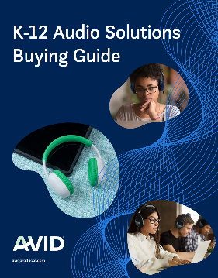

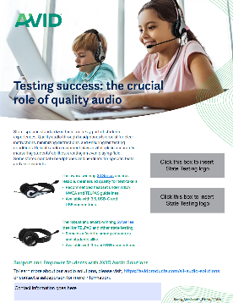
AVID Resources
AVID Partner Portal (https://fileshare.avidproducts.com/)
link available at avidproducts.com top nav bar
Username: avideducation
Password: learnaboutavid!
Product sell sheets
Product Catalog
Headset checklist
Comparison charts
Reseller campaign toolkits (e.g. back to school)
Education featured headset flyer
Product images
Why AVID presentation
MSRP price list

Slide 23
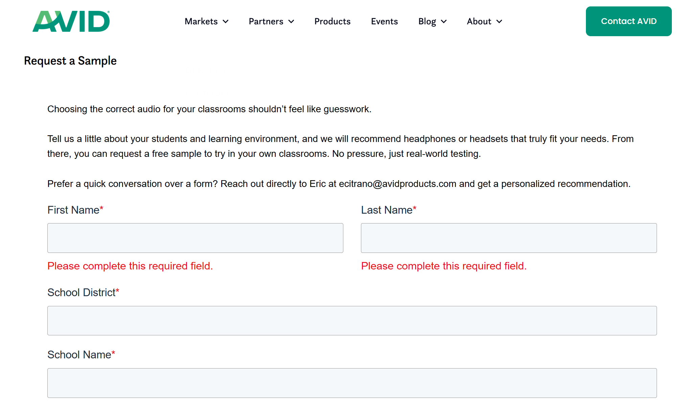
AVID Customer Samples
AVID Customer Sample Request Form: Sample Request
https://avidproducts.com/sample-request

Slide 24
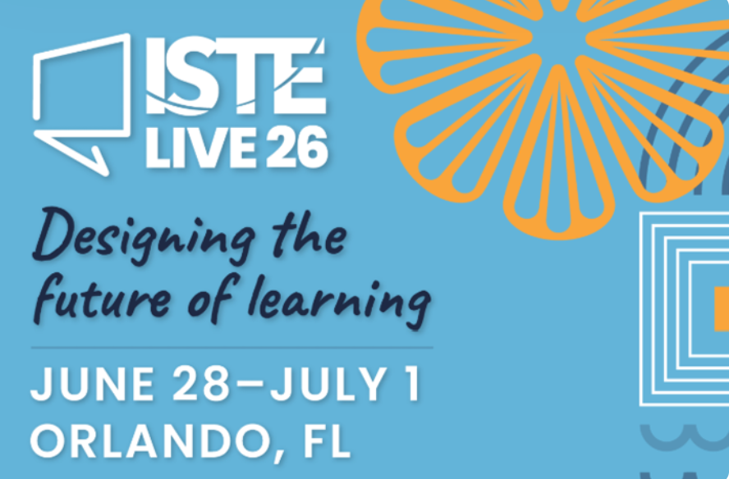
Upcoming Education Event
Booth #2946

Slide 25





Our Partnership Value
The AVID team is here to support your success and deliver
exceptional solutions to the education market
Sales
Marketing
Quick quote response
Price stability
Inventory availability
Demand gen & leads
MDF Program
Co-branded collateral
Financial
Operations
Solid margins
Special deal pricing
Sales incentives
U.S. based inventory
Ability to drop ship
End-to-end supply chain

Slide 26
Classroom-Tested Audio Solutions
Let’s shape the future of audio learning in education together.

